Slide 1


Introduction to Data Science & AI
SIT112 | Intro to Data Science & AI
Lecture Week 1 - Part 1 (Unit Outline)

Slide 2
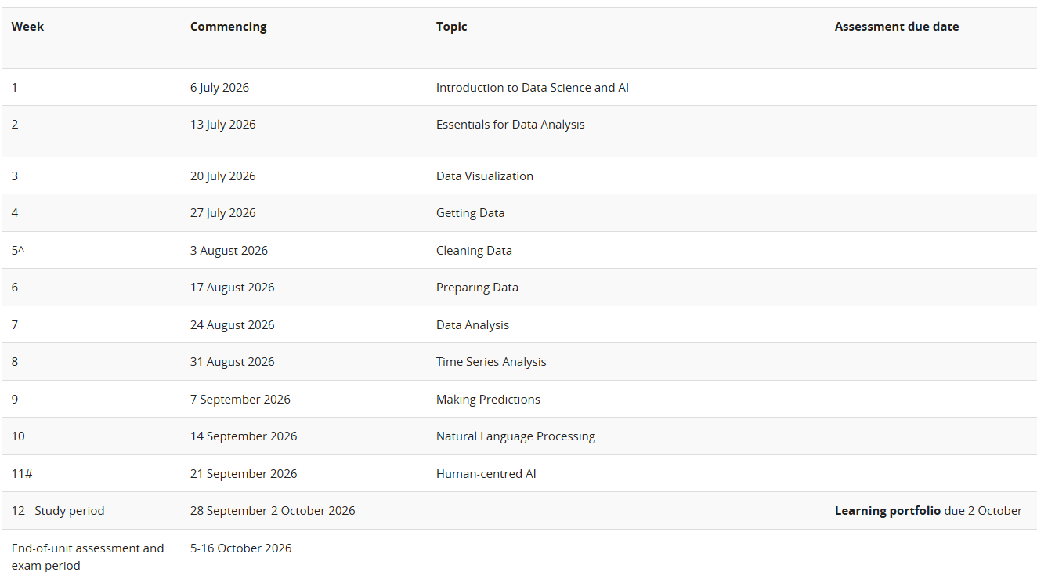


Slide 3
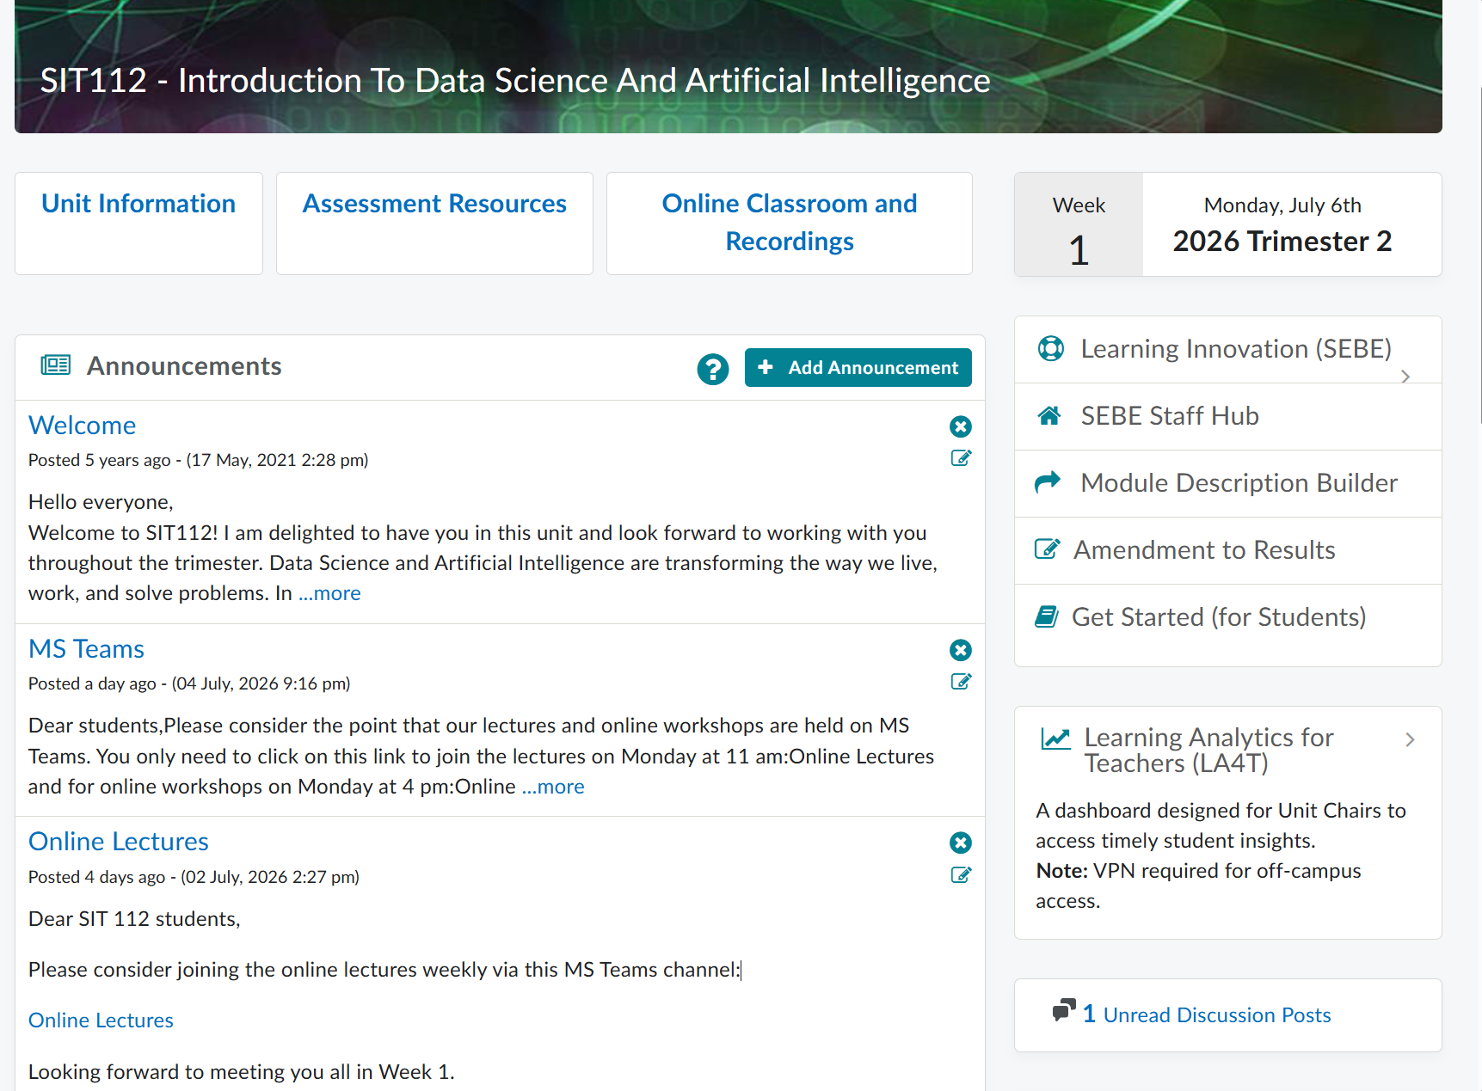
Lectures: How to Access
The link for the (online) lectures is provided on CloudDeakin.

Slide 4
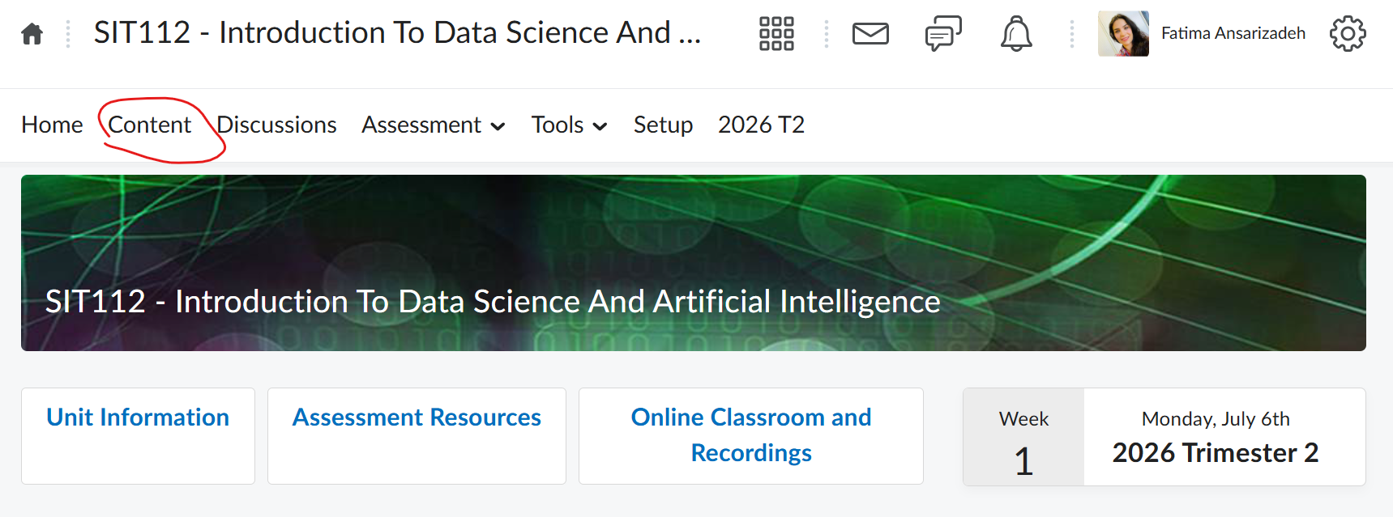
Lectures: Content
Recorded lectures can be accessed from CloudDeakin.

Slide 5
Workshops
Links for the Online workshops are provided on CloudDeakin and MS Teams.
Workshops are the primary venue for you to ask technical questions and get help on the tasks.
You can ask for feedback from your tutors in the workshops.
The tutors will walk you through the tasks and help you complete them:
Pass tasks: you will be guided to complete the tasks.
Credit tasks: limited guidance will be provided to complete the tasks.
Distinction and High Distinction tasks: are to be completed independently; the tutors can still give you hints and tell you if you are on the right track.

Slide 6
Workshops: Structure
1. Introduce
The tutor will introduce the students to the workshop and recap on the contents of the previous week.
2. Work on
The students will work on the activities/tasks while the tutor oversees them and answers their questions.
3. Explain
The tutor will provide more guidance or walk the students through the solutions when appropriate.
4. Continue
The students will continue to work on the activities/tasks while the tutor oversees them and answers their questions.

Slide 7
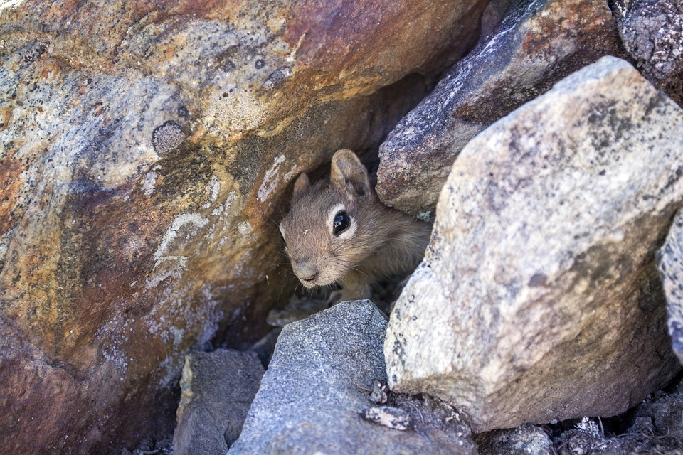
Workshops: One-To-One Online Sessions
Don’t be shy to ask for help!
It is okay not to know ☺
One-to-One Sessions (breakouts) can be arranged during the Online workshops; ask your tutor!
Use this responsibly, as other students might need help too ☺

Slide 8
Workshops: Dos and Don’ts!
Please avoid emailing code or screenshots of your code to the teaching team outside workshop hours; instead, demonstrate your solutions (code/report) to the tutors during the workshops.
The tutors can help you fix your code in a one-to-one discussion. They can also show you how to use external resources (e.g., ChatGPT) to fix your code while improving your programming/problem solving skills.
Please bring your own Windows/Mac/Linux laptop to the workshop; do not use tablets or Chromebooks for completing the tasks.

Slide 9
Assessment: Tasks
Task | Definition
Pass Tasks P1-P8 | To achieve the minimum acceptable standard for this unit. To complete the Pass tasks, students should be able to comprehend and execute solutions implemented in Python and write code for basic problems with guidance.
Credit Tasks C1-C2 | Students will apply what they have learnt in the pass tasks with less guidance. To complete the Credit tasks, students should be able to understand and implement solutions in Python and write code for basic problems with limited guidance.
Distinction Task D1 | Students will apply their advanced knowledge to design and build solutions to a real-world scenario. To complete the Distinction tasks, students should be able to independently comprehend and implement solutions in Python and write code for moderately complex problems.
High Distinction Task HD1 | Students will extend their understanding to demonstrate greater technical ability in developing more complex solutions to a real-world scenario. To complete the High Distinction tasks, Students should be able to comprehend and execute solutions implemented in Python and write code for complex problems independently.

Slide 10
Assessment : Set a Target Grade
Target Grade | Minimum Requirements
Pass | All the Pass tasks are completed. Failure to complete any of the Pass tasks will result in a Fail grade.
Credit | Minimum requirements for a Pass grade are met AND all Credit tasks are completed.
Distinction | Minimum requirements for a Credit grade are met, AND the Distention task is completed. The student must create a video recording presenting their completed task; they may be required to answer questions or make changes to their code.
High Distinction | Minimum requirements for a Distinction grade are met, AND all High Distinction tasks are completed. Interviews are required. The students will be asked questions about their submissions, and they will be required to complete small tasks during the interviews.

Slide 11
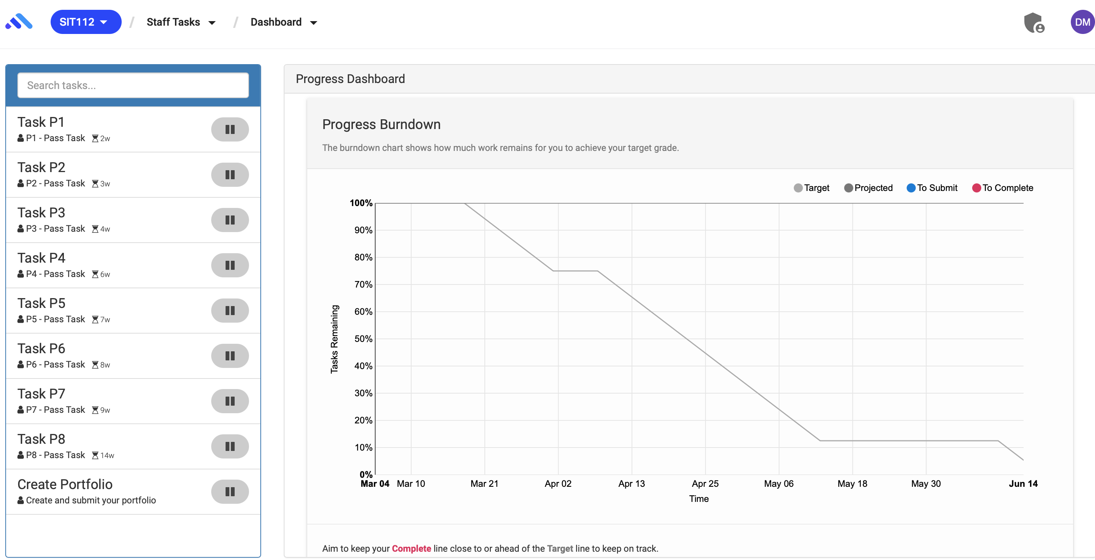
Assessment: OnTrack Task List

Slide 12
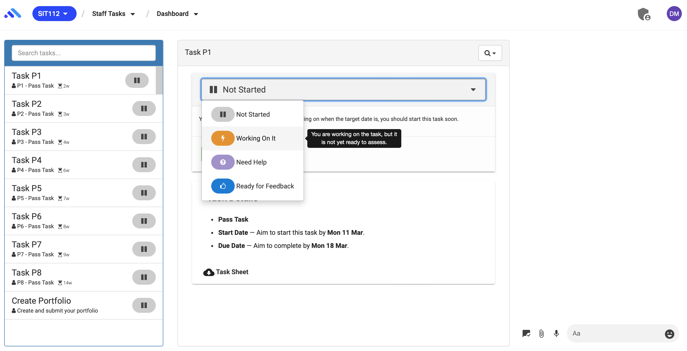
Assessment: Working on a Task

Slide 13
Assessment: Complete the Tasks
Knowledge and skills in this unit continuously build on those learnt in the weeks before. Therefore, if you fall behind, it becomes difficult to understand the subsequent content; try to submit your tasks by 11 am on the due dates. If you miss a due date, you can still submit your task by the end of Week 12 (The Deadline). However, only submissions by 11 am of the due date will receive feedback (via OnTrack).
Having said that, you can still ask for help on overdue tasks during the workshops, although the priority goes to the current tasks (released and not due yet).
Before completing any task, please read the instructions in the task description and task completion form; submit via OnTrack: https://ontrack.deakin.edu.au/.

Slide 14
Assessment: Submission Items
Task | Submission Items
Pass Tasks P1-P8 | P1: Sign and submit the assessment guideline via OnTrack. P2-P8: Submit the task completion report (PDF file) via OnTrack.
Credit Tasks C1-C2 | Submit the task completion report (PDF file) via OnTrack. Submit the Jupyter Notebook (ipynb file) via OnTrack.
Distinction Task D1 | Submit the task completion report (PDF file) via OnTrack; a link to the video recording must be included in the task completion report. Submit the Jupyter Notebook (ipynb file) via OnTrack.
High Distinction Task HD1 | Submit the task completion report (PDF file) via OnTrack; a link to the video recording must be included in the task completion report. Submit the Jupyter Notebook (ipynb file) via OnTrack.

Slide 15
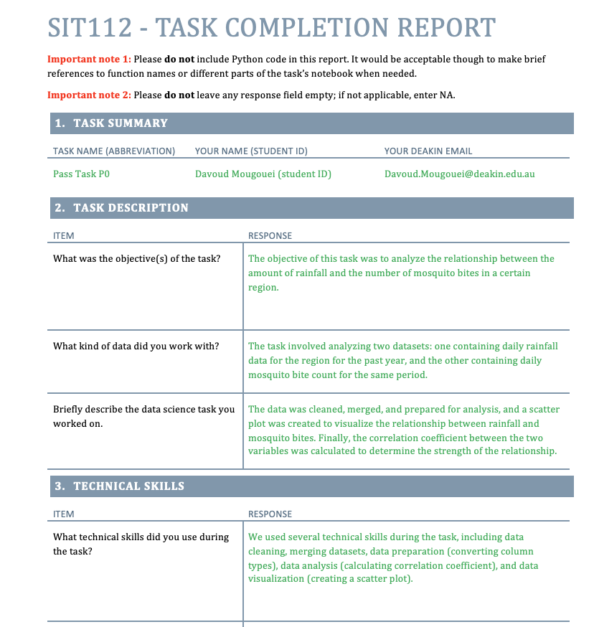
Task Completion Report

Slide 16
Assessment: Feedback
Feedback | Meaning | Required Action
Complete | The submission meets the essential requirements of the task and is ready for inclusion in the portfolio. | No further action is required.
Discuss | The tutor would like to discuss the submission with the student. | Respond to the tutor’s questions via OnTrack.
Demonstrate | The tutor would like the student to demonstrate the submission. | Meet with the tutor (online/on-campus) to demonstrate your submission.
Fix and Resubmit | The submission needs to be improved or fixed. | Fix your submission and resubmit. Maximum of 2 resubmissions are allowed per task, but only the first resubmission will receive further feedback – only if it is received within 7 days of the initial feedback. The 2nd resubmission can be made anytime by the end of Week 12 (the Deadline) with no feedback.
Fail | The submission has failed to meet the essential requirements of the task. | No action is required.
You are not allowed to make more than 3 submissions per task (original submission plus a maximum of 2 resubmissions).
If you mistakenly exceeded this limit, please contact your tutor; they will help you fix the issue.

Slide 17
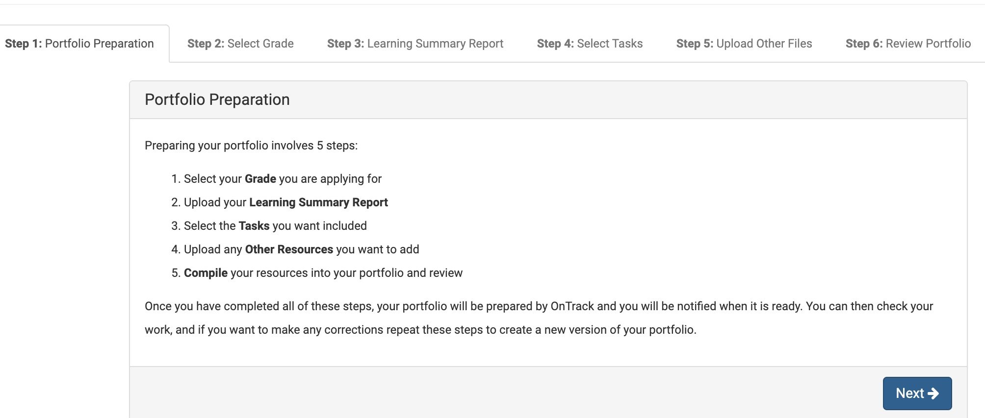
Assessment: Portfolio submission
By the end of Week 12, you will need to create your final portfolio, including all your completed tasks.

Slide 18

No Extensions for the Tasks!
Please note the difference between the Due Date of a task and the Deadline.
A Due Date aims to regulate the feedback process; it cannot be extended.
There is one Deadline for all tasks, and it cannot be extended: End of Week 12 - Friday.
The student cannot expect feedback via OnTrack if they submit a task after the due date, but their submission will still be marked as long as it is submitted by the deadline; feedback can be provided during the workshops.

Slide 19
Assessment: Plagiarism
SIT112 has zero tolerance for plagiarism; plagiarised submissions will be flagged as Fail and reported to the academic integrity committee for further investigation.
Notes:
When you submit work to be marked that uses the work, words and ideas of others and haven’t acknowledged them properly, you are pretending that it is all your own work when it isn’t. You are trying to get credit for other people’s work.

Slide 20
Help-Hub Sessions (Online)
HelpHub sessions can be accessed from the CloudDeakin site.
You can ask programming questions and get support on the tasks.
You can attend multiple HelpHub sessions if you need help.
Please do not use HelpHub as a replacement for the Workshops.

Slide 21
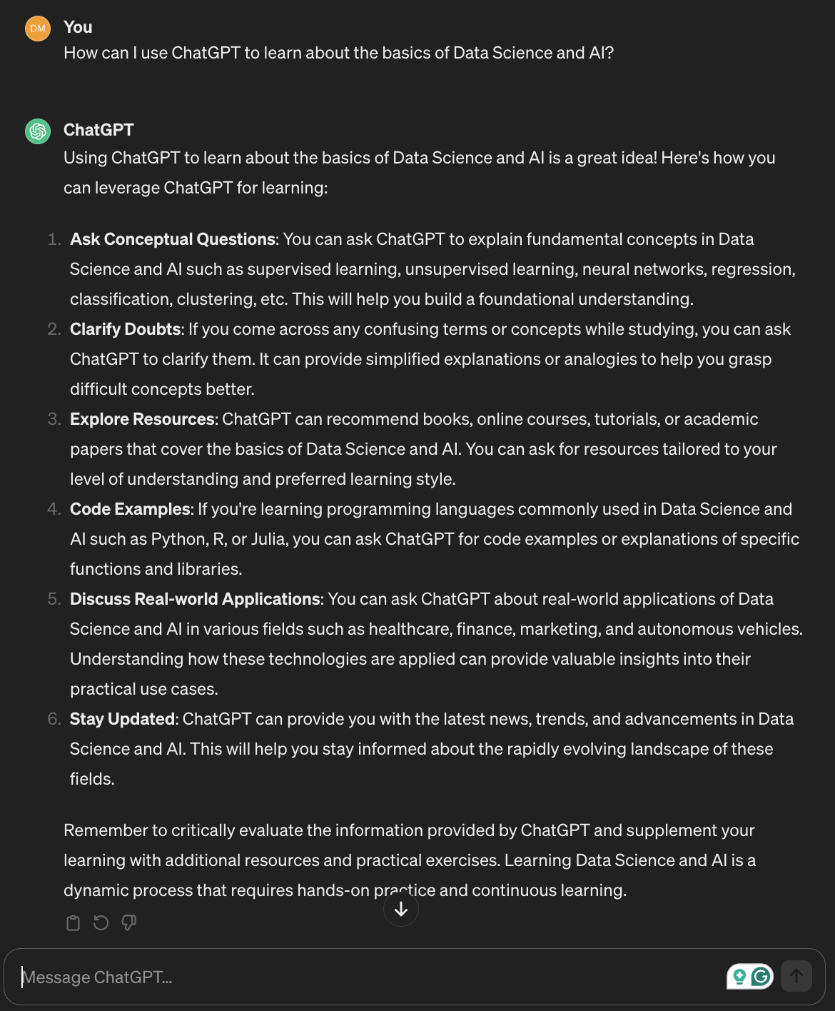

ChatGPT
In this unit, we encourage you to use ChatGPT when appropriate.
The tutors will help you navigate your way through this new world of AI in education to have an enjoyable learning experience!

Slide 22
Communication – Asking Questions
Technical Questions:
Any technical questions about the lectures or tasks should be asked during the Workshops.
If you are attending the online workshops, you can ask your tutors to help you in a one-to-one (breakout) session.
Non-Technical Questions:
Directly email the unit chair: f.ansarizadeh@deakin.edu.au
Your subject line must contain: SIT112
For any email sent, your subject line must contain "SIT112” without the quotation mark.
Emails that do not follow this rule in the subject line may get a delayed response or get buried in a busy mailbox.
You can expect an answer within 2 working days.
You can also directly message me on MS Teams.

Slide 23

Communication - Announcements
We use CloudDeakin announcements to communicate any updates, news, and changes about the lectures, workshops, tasks, etc.
You are expected to read the announcements carefully.

Slide 24
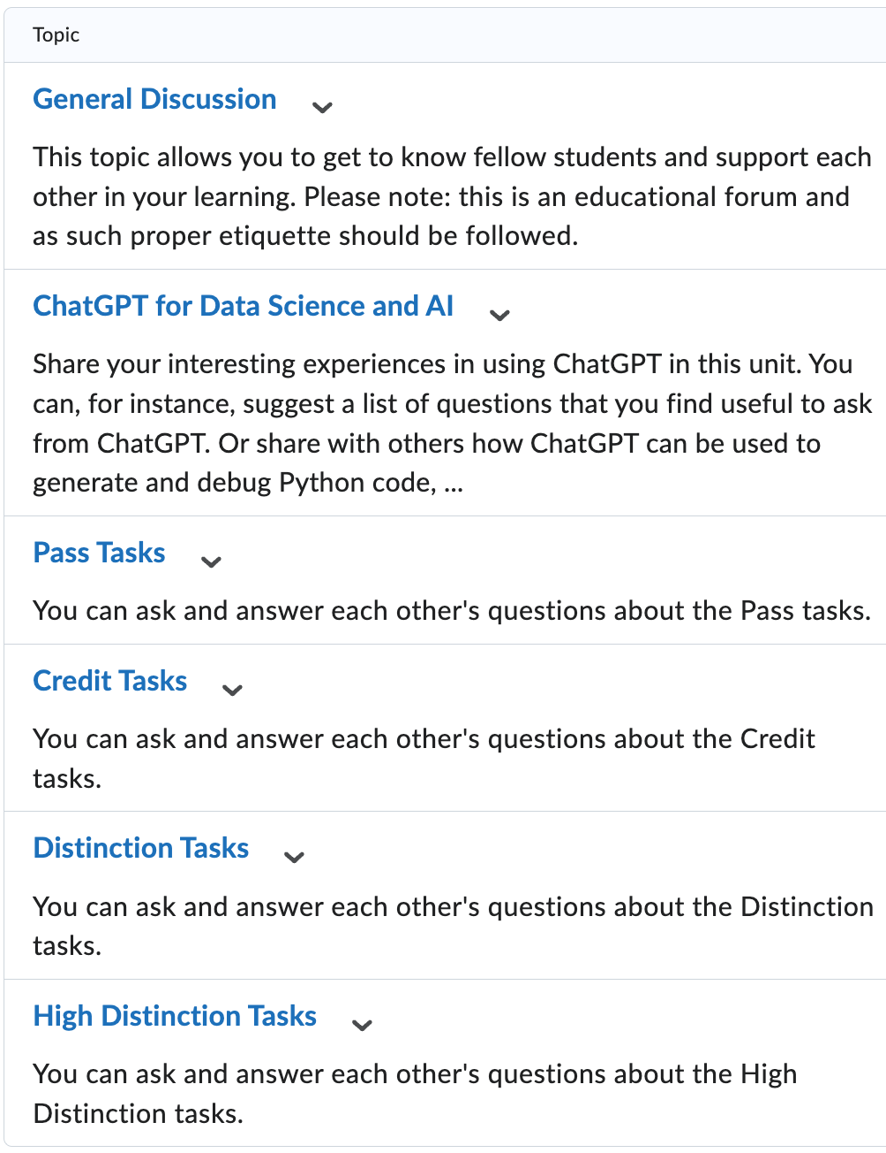
Discussions
During the Workshops: we may allocate some time to discussion.
Outside the Workshops: you can continue to discuss on the student forum.
The student forum is to encourage discussion among the students; they are not frequently monitored by the teaching team.

Slide 25
Best Practices
Work on your tasks as early as possible; do not procrastinate!
Demonstrate your work to the tutors and ask for in-class feedback. That is especially useful for Credit, Distinction, and High Distinction tasks. Your tutors can tell you how far your task is from completion.
Try not to miss the due dates; you still can resubmit if the tutor did not flag your initial submission as complete ☺
Learn how to use ChatGPT as your personal tutor!
Set a realistic target grade that matches your skills, the grade requirements, and your career/study plans. If you are not sure, talk to the teaching team; they will be able to guide you.
Feel free to communicate any obstacle that prevents you from achieving your target grade; we can always help you overcome it - as long as the target grade is set realistically.
Be respectful to the tutors; they are there to help you achieve your goals!
Stay positive and don’t be stressed; teaching and learning must be joyful ☺

Slide 26

Something about this unit has made me feel stressed. What should I do?
Step 1: Relax and take a deep breath ☺
Step 2: Take some time to reflect on what’s really concerned you. Make sure you have fully understood the requirements of the unit as in the Assessment Guideline.
Step 3: Communicate your concern, respectfully, with the teaching team; we can always find a way to help you if you have a legitimate concern.
Step 4: Give the teaching team some time to find a solution and get back to you.
Step 5: If you did not hear from us in 2 working days, feel free to follow up.

Slide 27

Can X be done differently? I (we) prefer …
We celebrate diversity and recognize your preferences.
We welcome feedback for future enhancements.
We cannot incorporate preferences into a running version of the unit.
To avoid confusion.
To ensure the unit's coherence and integrity.
We thank you for your understanding and cooperation.

Slide 28
References
Data science from scratch: first principles with Python, Joel Grus, O'Reilly Media, 2019
Python for Data Analysis: Data Wrangling with Pandas, NumPy, and IPython, Wes McKinney, O'Reilly Media, 3rd edition, 2022.
Python Data Science Handbook: Essential Tools for Working with Data, Jake Vanderplas, O'Reilly Media, 2022
Murach’s Python for Data Analysis, Scott McCoy, Mike Murach & Associates, Incorporated, 2021.
Intro to Python for Computer Science and Data Science: Learning to Program with AI, Big Data and The Cloud, Paul Deitel, Pearson Education Limited, 2021.
Artificial Intelligence: a Modern Approach, Global Edition, Stuart Russell , and Peter Norvig, Pearson Education, 2021.

Slide 29
Online Resources
https://towardsdatascience.com/
https://www.datasciencecentral.com/
https://www.kdnuggets.com/
https://www.kaggle.com/

Slide 30
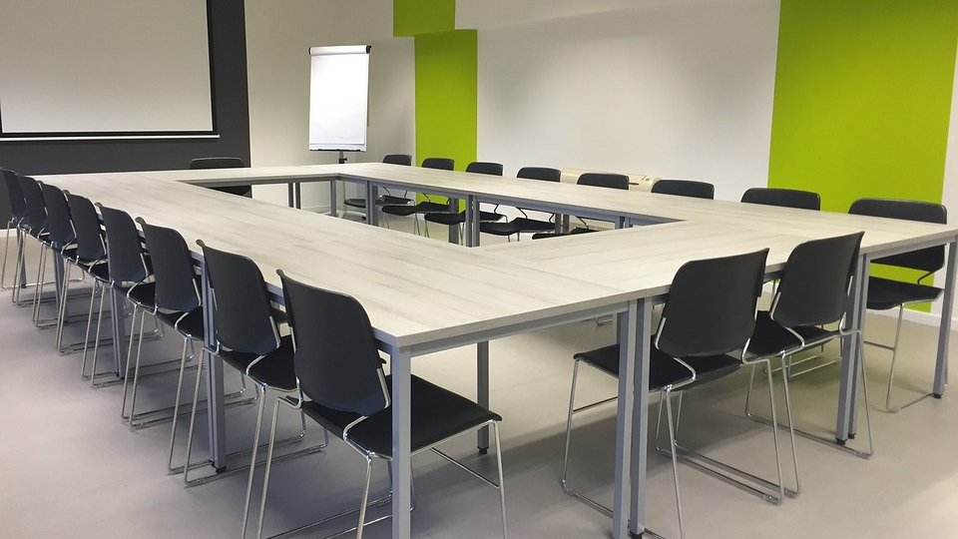
End of part 1 …

